Slide 1
Invasive brain-computer interface study:
Intracranial & Intracortical EEG
From BioMechatronics and BioRobotics Laboratory
of Shanghai Jiaotong University
http://bbl.sjtu.edu.cn/
Xie Tao|2015.09.25

Slide 2
Introduction | Intraoperative ECoG | Stereo-EEG | MRCP | platform | Further
Introduction

Slide 3
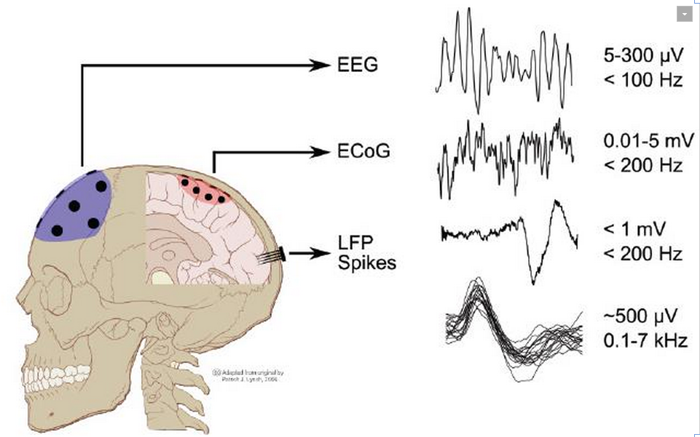
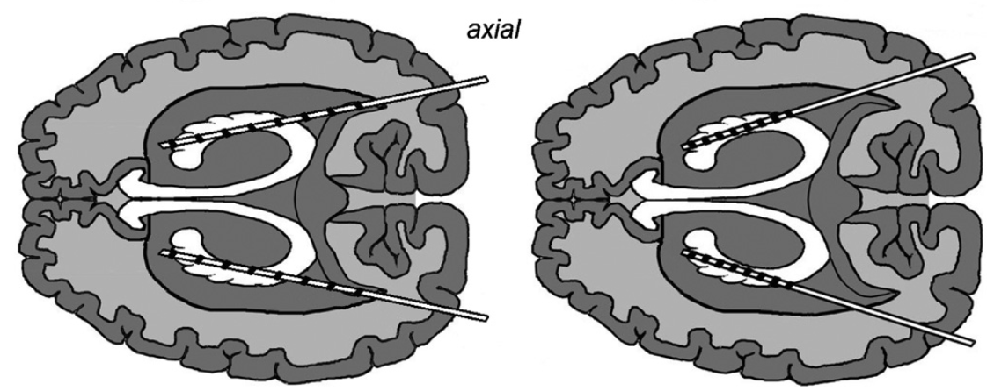
Introduction | Intraoperative ECoG | Stereo-EEG | MRCP | platform | Further
Intracranial EEG:
ECoG signals during Intraoperative awake craniotomy, e.g. brain tumor (肿瘤) and intractable epilepsy (癫痫);
ECoG signals during extraoperative seizure moitoring processes, mainly epilepsy patients.
Intracortical EEG:
Stereoelectroencephalography (sEEG) uses “depth electrodes” consisting of very thin (approximately 1–2 mm), flexible cylindrical leads with multiple concentric metal electrodes along the length of the lead. Whereas SEEG was originally described by Bancaud et al. in 1965, it has only become increasingly used in the US since 2009.
Fortunately, Huashan Hospital is one of the few institutions in China that could have access to both ECoG and sEEG signal.
Stereo-EEG (sEEG)

Slide 4
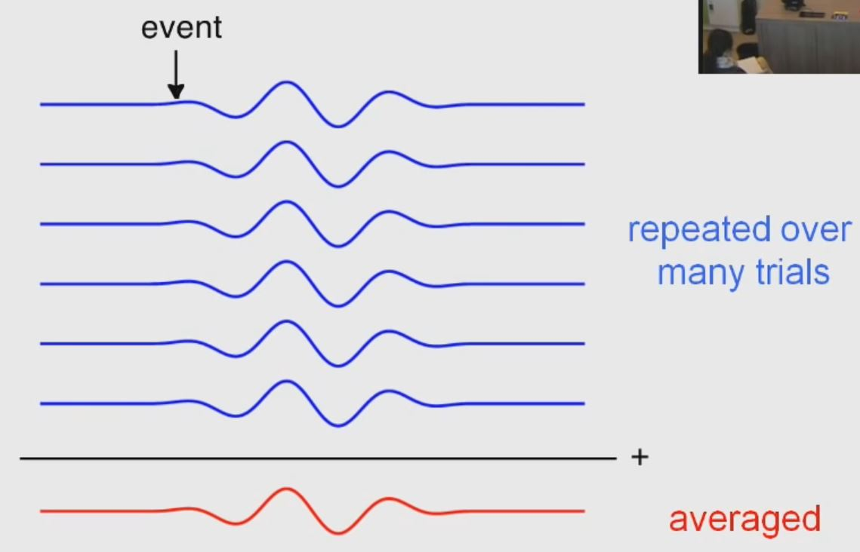

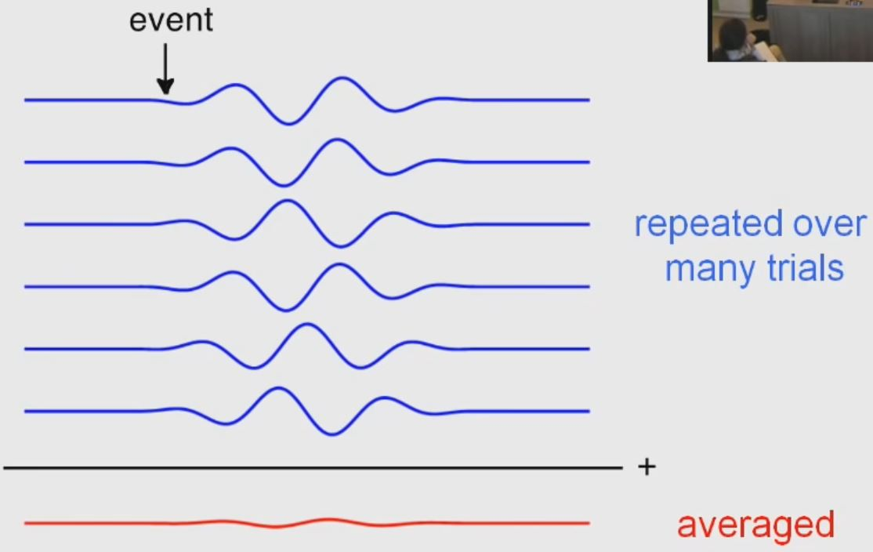
Introduction | Intraoperative ECoG | Stereo-EEG | MRCP | platform | Further
Electrophysiological characteristics of brain signal:
事件相关电位(event-related potential, ERP), 根据刺激事件诱发的脑电波形具有锁时(time locked and phase locked)特性，通过多次重复试验后叠加平均，最终能得到淹没在自发脑电信号中的微弱ERP波形；
事件相关去同步与同步方法(event-related (de)synchronization, ERD/ERS), 所分析的对象为EEG信号中的不同频段的信号，根据信号与刺激时间的锁时但不锁相(time locked but not phased locked)特点，信号通过某一频带的带通滤波器，再对其幅值进行平方后叠加平均得到某一频带的EEG信号能量随时间的变化波形，随后该波形减去基线平均值再除以基线平均值，得到刺激事件发生后各时间段相对于刺激事件前频带能量(band power, BP)的变化情况. 带通能量的减少被称为ERD, 能量的增加被称为ERS, 其大小则为ERD/ERS 的强度
Event-related potential, ERP
Event-related (de)sychronization, ERD/ERS

Slide 5
Introduction | Intraoperative ECoG | Stereo-EEG | MRCP | platform | Further
Intraoperative ECoG

Slide 6
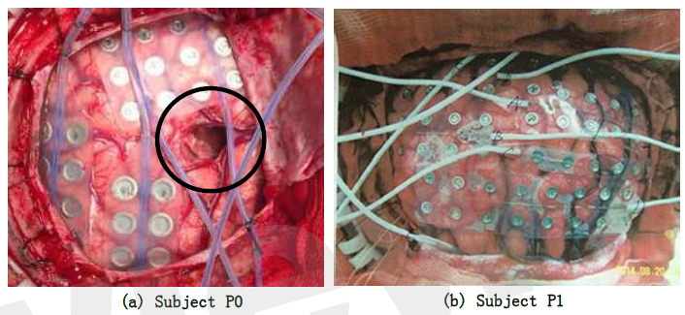
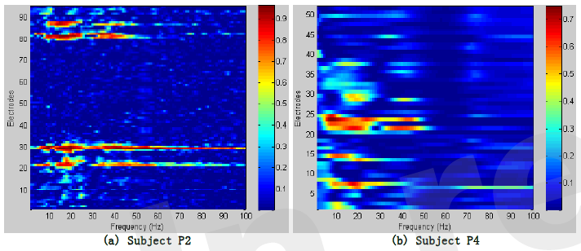
Introduction | Intraoperative ECoG | Stereo-EEG | MRCP | platform | Further
Frontiers in Neuroscience, (accepted sep 2015)
Classifying Multiple Types of Hand Motions Using Electrocorticography During Intraoperative Awake Craniotomy & Seizure Monitoring Processes - Case Studies
Tao Xie, Dingguo Zhang*, Zehan Wu, Liang Chen*, Xiangyang Zhu
Shanghai Jiao Tong University & Huashan Hospital, Fudan University
Main findings of the thesis:
This study verified the possibility of decoding multiple hand motion types during an awake craniotomy, which is the first step towards dexterous neuroprosthetic control during surgical implantation, in order to verify the optimal placement of electrodes.
The accuracy during awake craniotomy was comparable to results during seizure monitoring.
This study also indicated that ECoG was a promising approach for precise identification of eloquent cortex during awake craniotomy, and might form a promising BCI system that could benefit both patients and neurosurgeons.
Subjects: 2 subjects during intraoperative awake craniotomy & 2 subjects during extraoperative seizure monitoring processes

Slide 7
Introduction | Intraoperative ECoG | Stereo-EEG | MRCP | platform | Further
Frontiers in Neuroscience, (accepted sep 2015)
Classifying Multiple Types of Hand Motions Using Electrocorticography During Intraoperative Awake Craniotomy & Seizure Monitoring Processes - Case Studies
Tao Xie, Dingguo Zhang*, Zehan Wu, Liang Chen*, Xiangyang Zhu
Shanghai Jiao Tong University & Huashan Hospital, Fudan University
Main findings of the thesis:
This study verified the possibility of decoding multiple hand motion types during an awake craniotomy, which is the first step towards dexterous neuroprosthetic control during surgical implantation, in order to verify the optimal placement of electrodes.
The accuracy during awake craniotomy was comparable to results during seizure monitoring.
This study also indicated that ECoG was a promising approach for precise identification of eloquent cortex during awake craniotomy, and might form a promising BCI system that could benefit both patients and neurosurgeons.
Subjects: 2 subjects during intraoperative awake craniotomy & 2 subjects during extraoperative seizure monitoring processes

Slide 8
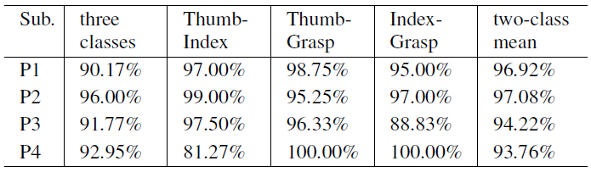
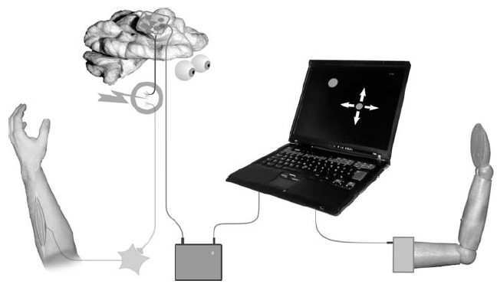
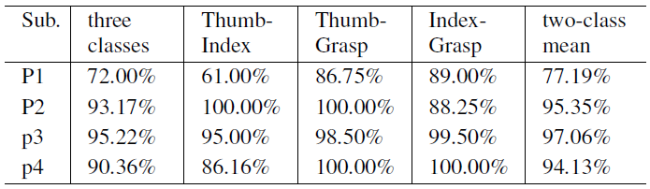
Introduction | Intraoperative ECoG | Stereo-EEG | MRCP | platform | Further
Main findings of the thesis:
This study verified the possibility of decoding multiple hand motion types during an awake craniotomy, which is the first step towards dexterous neuroprosthetic control during surgical implantation, in order to verify the optimal placement of electrodes.

Slide 9
Introduction | Intraoperative ECoG | Stereo-EEG | MRCP | platform | Further
Frontiers in Neuroscience, (accepted sep 2015)
Classifying Multiple Types of Hand Motions Using Electrocorticography During Intraoperative Awake Craniotomy & Seizure Monitoring Processes - Case Studies
Tao Xie, Dingguo Zhang*, Zehan Wu, Liang Chen*, Xiangyang Zhu
Shanghai Jiao Tong University & Huashan Hospital, Fudan University
Main findings of the thesis:
This study verified the possibility of decoding multiple hand motion types during an awake craniotomy, which is the first step towards dexterous neuroprosthetic control during surgical implantation, in order to verify the optimal placement of electrodes.
The accuracy during awake craniotomy was comparable to results during seizure monitoring.
This study also indicated that ECoG was a promising approach for precise identification of eloquent cortex during awake craniotomy, and might form a promising BCI system that could benefit both patients and neurosurgeons.
Subjects: 2 subjects during intraoperative awake craniotomy & 2 subjects during extraoperative seizure monitoring processes

Slide 10
Introduction | Intraoperative ECoG | Stereo-EEG | MRCP | platform | Further
Main findings of the thesis:
This study also indicated that ECoG was a promising approach for precise identification of eloquent cortex during awake craniotomy, and might form a promising BCI system that could benefit both patients and neurosurgeons.
Real-time identification of eloquent cortex during an awake craniotomy
(点我)

Slide 11
Introduction | Intraoperative ECoG | Stereo-EEG | MRCP | platform | Further
Stereoelectroencephalography (sEEG)
A promising signal for brain-computer interface

Slide 12
Introduction | Intraoperative ECoG | Stereo-EEG | MRCP | platform | Further
Clinical Neurophysiology, 2002. (study was done by Salengro Hospital, France)
Basic mechanisms of central rhythms reactivity to preparation and execution of a voluntary movement: a stereoelectroencephalographic study William Szurhaja, Philippe Deramburea, Etienne Labyta, Francois Cassima, Jean-Louis Bourrieza, Jean Isnardb, Jean-Daniel Guieua, Franc¸ois Mauguie`re
in order to locate more precisely the sources of the reactivity of the EEG rhythms related to a volunt-ary Movement.
Subjects: 3 epilepsy patients and explored by sEEG for epileptic focus localization. Each electrode had 10–15 contacts, 2 mm length each, separated by 1.5 mm.
Task: Before the intracerebral exploration, we performed a scalp EEG study to check that the subjects were presenting usual patterns of ERD/ ERS of mu and beta rhythms.
Movement had to be brisk and brief, and separat-ed one from the other by an interval superior to 10 s. Subject no. 1 (right index finger), subjects nos. 2 and 3 (left index finger).
Method: we selected contacts located in pre-central gyrus, post-central gyrus, frontal medial cortex and frontal lateral cortex. And ERD/S of the scalp EEG and sEEG was calculated.
Conclusions: An ERD of mu and beta rhythms has been recorded before the movement onset in the precentral gyrus, spreading then to the
postcentral gyrus and to the frontal medial cortex.
The primary motor area seems to contain two distinct areas with different reactivity to the movement preparation and execution.
sEEG 可用于研究脑功能定位，同时实现精确脑机接口研究。

Slide 13
Introduction | Intraoperative ECoG | Stereo-EEG | MRCP | platform | Further
European Journal of Neuroscience, 2005. (study was done by Salengro Hospital, France)
Intracerebral study of gamma rhythm reactivity in the sensorimotor cortex
William Szurhaj, Jean-Louis Bourriez, Philippe Kahane, Patrick Chauvel, Franc¸ois Mauguie`re and Philippe Derambure
European Journal of Neuroscience, 2006.
Relationship between intracerebral gamma oscillations and slow potentials in the human sensorimotor cortex William Szurhaj, Etienne Labyt, Jean-Louis Bourriez, Philippe Kahane, Patrick Chauvel, Franc¸ois Mauguie` re, and Philippe Derambure
Brain, 2004. (study was done by University of Toronto, Canada)
Involvement of human thalamus in the preparation of self-paced movement
Guillermo Paradiso, Danny Cunic, Jean A. Saint-Cyr, Tasnuva Hoque, Andre´s M. Lozano,Anthony E. Lang and Robert Chen
The Journal of physiology, 2005.
Movement-related frequency modulation of beta oscillatory activity in the human subthalamic nucleus G. Foffani, A. M. Bianchi, G. Baselli and A. Priori

Slide 14
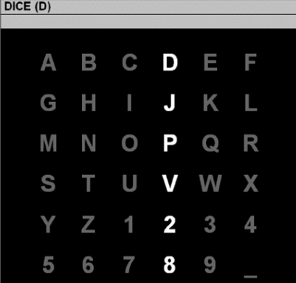
Introduction | Intraoperative ECoG | Stereo-EEG | MRCP | platform | Further
Journal of neural engineering, 2011 (study was done by Old Dominion University and Mayo clinic, USA)
Control of a brain–computer interface using stereotactic depth electrodes in and adjacent to the hippocampus Dean J. Krusienski and Jerry J. Shih
this study is the first to demonstrate the use of human hippocampal and adjacent signals to control a brain–computer interface. The ability to utilize a SDE-based P300 Speller for communica-tion may improve the risk/benefit ratio for chronic intracranial implantation compared to ECoG with grid electrodes.
Subjects: 2 epilepsy patients explored by sEEG for epileptic focus localization.
Task: The task was to focus attention on a pecified letter of the matrix and silently count the number of times the target character flashed, until a new character was specified for selection.
Results: Both subjects were able to accurately spell words via the P300 Speller using depth electrode signals.
Conclusion: These preliminary results indicate that adequate performance can be achieved using a unilateral array or possibly even a single SDE. We believe a SDE-based P300 Speller with the same efficiency and accuracy as an ECoG based P300 Speller may represent a better long-term option for patients needing chronic brain–computer interface devices for communication control.
Eva Ludowig, Christian G. Bien .etc. Two P300 Generators in the Hippocampal Formation, Hippocampus, 2010

Slide 15
Introduction | Intraoperative ECoG | Stereo-EEG | MRCP | platform | Further
IEEE International Conference on Systems, Man, and Cybernetics, 2012.
Spectral Components of the P300 Speller Response In and Adjacent to the Hippocampus
Dean J. Krusienski and Jerry J. Shih
Journal of Neuroscience Methods, 2012. (study was done by Mayo clinic and Old Dominion University)
Signals from intraventricular depth electrodes can control a brain–computer interface
Jerry J. Shih and Dean J. Krusienski
The location of the recording electrodes and the types of responses obtained are areas of active research. We report a proof of concept case in which ERPs from intraventricular electrodes were used to control the P300 Speller BCI paradigm.
Subjects: 1 epilepsy patient explored by sEEG for epileptic focus localization.
Task: The task was to focus attention on a pecified letter of the matrix and silently count the number of times the target character flashed, until a new character was specified for selection.
Conclusion: The present case demonstrates as proof of concept that recording electrodes in the lateral ventricle adjacent to hippocampus can be used to control a brain–computer interface. Since the classifiers were trained and tested using data from successive days, the favorable classification performance indicates that the ERPs are consistent across multiple days.

Slide 16
Introduction | Intraoperative ECoG | Stereo-EEG | MRCP | platform | Further
Neurosurg Focus, 2013. (study was done by Cleveland Clinic, USA)
Stereoelectroencephalography for continuous two-dimensional cursor control in a brain-machine interface Vadera, S. Marathe, A. R. Gonzalez-Martinez, J. Taylor, D. M.
To date, there have been very few BMI studies conducted using SEEG, and none, to our knowledge, have investigated the feasibility of using SEEG for continuous control of 2D cursor ovements.
Subjects: 2 epilepsy patients and explored by sEEG for epileptic focus localization.
Task: The participants were instructed to wiggle their hands when they needed to steer the cursor right and to rest their hands. when they needed to steer the cursor left; similarly they were instructed to wiggle their feet when they needed to steer the cursor down and rest their feet when they needed
to steer the cursor up.
Conclusions: further post hoc analysis suggested that better directional control could have been achieved by including only the electrode contacts that were directly in the hand and foot motor areas and excluding contacts conveying unrelated activity.
potentially be placed bilaterally, acquiring
separate signals from both left versus right hand and left versus right foot regions. Bilateral implants could theoretically provide 4 relatively independent control signals for more complex BMI applications.

Slide 17
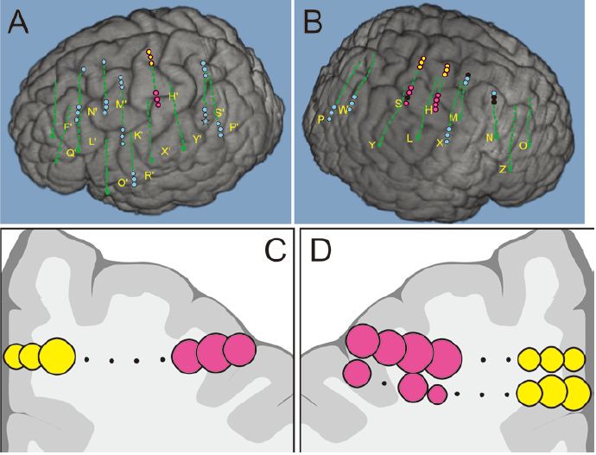
Introduction | Intraoperative ECoG | Stereo-EEG | MRCP | platform | Further
Neurosurg Focus, 2013. (study was done by Cleveland Clinic, USA)
Stereoelectroencephalography for continuous two-dimensional cursor control in a brain-machine interface Vadera, S. Marathe, A. R. Gonzalez-Martinez, J. Taylor, D. M.

Slide 18
Introduction | Intraoperative ECoG | Stereo-EEG | MRCP | platform | Further
sEEG的脑机接口研究目前才刚刚开始，第一篇sEEG控制二维光标的研究于2013年6月发表在Neurosurg Focus上[1]，目前还没有采用sEEG控制假肢手的研究。此外还有两篇采用sEEG虚拟打字机的研究[2][3]。 sEEG与ECoG都属于local field potentials (LFPs)，时频信号特征是相似的，区别在于ECoG在皮质表层而sEEG需要植入到皮质内部。基于sEEG的BCI研究有如下几个特点：
sEEG采集是不需要开颅的，只需将针状电极植入颅内即可，减少了外科手术风险。sEEG电极可以长期留在颅内（部分病人可以植入sEEG电极2~3周），且病人的自主活动能力优于阵列电极ECoG病人，有利于long-term BCI研究；
sEEG不仅可以获取大脑皮层信号（如运动感知皮层等），还可以获得深部脑区信号（如海马区等），为进一步研究脑电运动信号传输机理，提高运动控制精度提供了有利途径；
目前基于ECoG的假肢手控制受限于电极植入区域，因而往往只能实现单侧控制。基于sEEG的假肢手控制则可以实现双侧控制
基于sEEG低外科手术风险、long-term study、高控制精度以及双侧控制等特点，且随着sEEG在临床癫痫诊断的广泛应用，sEEG有望成为一种极具潜力的植入式BCI的信号源，为植入式BCI在瘫痪病人中的应用提供了新的方法。

Slide 19
Introduction | Intraoperative ECoG | Stereo-EEG | MRCP | platform | Further
Movement-related cortical potential (MRCP)

Slide 20
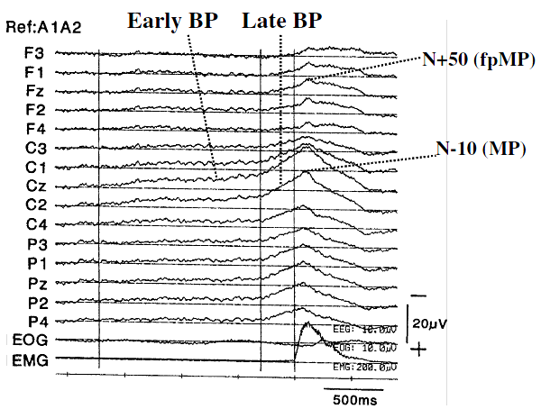
Introduction | Intraoperative ECoG | Stereo-EEG | MRCP | platform | Further
Since discovery of the slow negative EEG activity preceding self-initiated movement by Kornhuber and Deecke (i.e. BP 1965) various source localization techniques in normal subjects and epicortical recording in epilepsy patients have disclosed the generator mechanisms of each identifiable component of movement-related cortical potentials (MRCPs) to some extent.
[H. Shibasaki, 2006]

Slide 21
Introduction | Intraoperative ECoG | Stereo-EEG | MRCP | platform | Further
BCI technologies provide the means for conveying control commands directly from the brain and can be used either for directly controlling rehabilitation devices (function recovery or replacement) or to provide feedback to the patient based on his/her brain activity (neuromodulation). [N. Jiang, 2015]
Neuromodulation can be used for example in stroke rehabilitation for inducing activity-dependent brain plasticity. However, any applications using neurofeedback require that a causality (因果关系) of action (at least the intention of action) and the corresponding feedback must be established, i.e. the patient needs to initiate (or intend to initiate) a motor task, and receive a corresponding feedback within a short delay (200~300ms), which can be perceived by the user as the result of the execution or imagination of the motor task.
A feedback triggered by Movement-related cortical potential (MRCP) has the potential to be used for inducing plasticity, i.e. Neuromodulation.

Slide 22

Introduction | Intraoperative ECoG | Stereo-EEG | MRCP | platform | Further
Neuromodulation based on EEG signal have been intensively study. Doctor N. Jiang has done lots of work in this area. Especially applying BCI for neurorehabilitation.
2011, Detection of movement intention from single-trial movement-related cortical potentials, Journal of Neural Engineering;
2014, Enhanced Low-Latency Detection of Motor Intention From EEG for Closed-Loop Brain-ComputerInterface Applications, IEEE TRANSACTIONS ON BIOMEDICAL ENGINEERING;
2015, A brain-computer interface for single-trial detection of gait initiation from movement related cortical potentials, Clinical Neurophysiology;
2015, Comparison of spatial filters and features for the detection and classification of movement-related cortical potentials in healthy individuals and stroke patients, Journal of Neural Engineering.

Slide 23
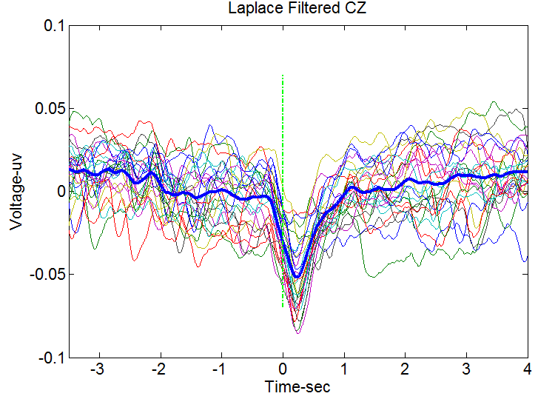
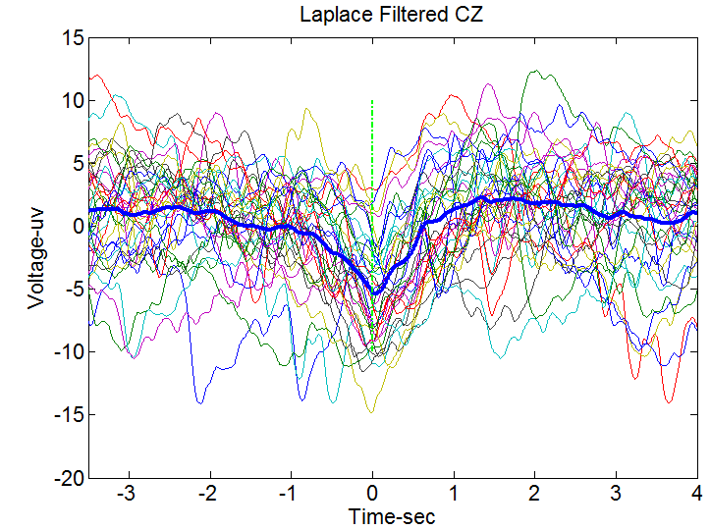
Introduction | Intraoperative ECoG | Stereo-EEG | MRCP | platform | Further
Subject 1
采集设备：NeuroScan; 采样频率：1250Hz； 硬件带宽设置：DC~200Hz ； 50Hz工频滤波。
此组数据主要看有提示和没有提示条件下的MRCP。在有提示的情况下，屏幕首先出现2s“十”指示条，提示动作开始，然后出现1.2s的红色方块，此时受试者快速动作，当红色方块消失时，动作也随即停止。在没有提示的情况下，受试者随机间隔5~10S动作。
Cue-right leg: Cz
Selfpace-right leg: Cz
[Source: SJTU BCI Lab]

Slide 24
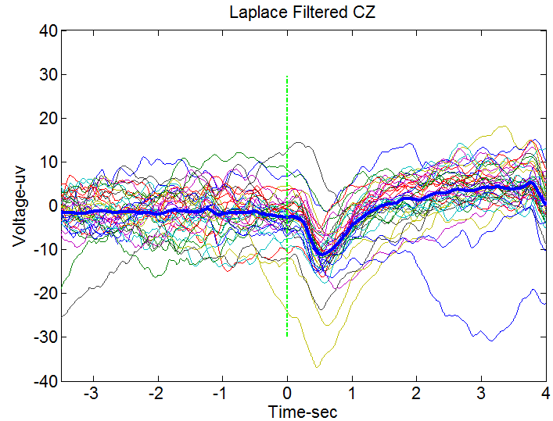
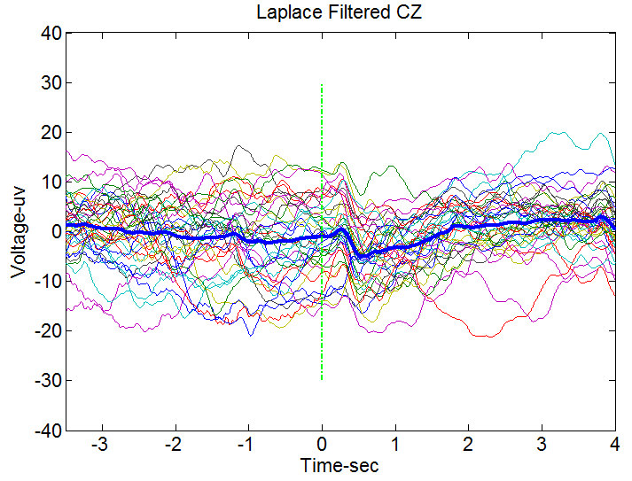
Introduction | Intraoperative ECoG | Stereo-EEG | MRCP | platform | Further
Subject 2
采集设备：Brain Product; 采样频率：1000Hz; 50Hz凹陷滤波; DC模; FPz(end); TP9,PT10(reference)
此组数据主要观测实际运动及想象运动状态下的MRCP。在有提示的情况下，屏幕首先出现2s“十”指示条，提示动作开始，然后出现1.2s的红色方块，此时受试者快速动作，当红色方块消失时，动作也随即停止。
Left leg real motion
Left leg motor imagery
[Source: SJTU BCI Lab]

Slide 25
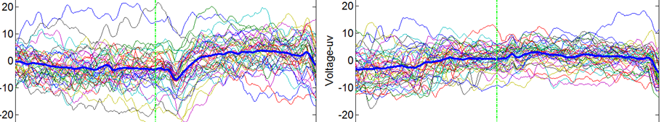
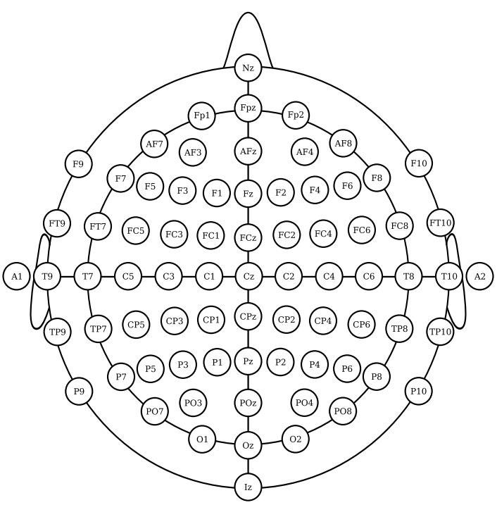
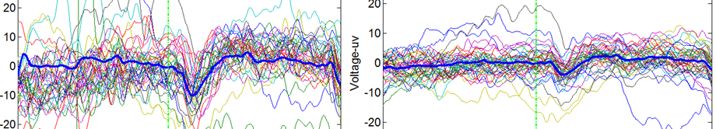
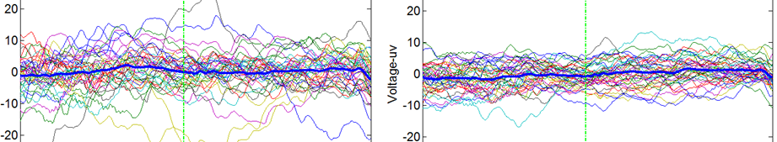
Introduction | Intraoperative ECoG | Stereo-EEG | MRCP | platform | Further
Subject 2
Right leg real motion
C3
C4
FC1
FC2
FC1
FC2
C3
C4
CP1
CP2
CP1
CP2
[Source: SJTU BCI Lab]

Slide 26
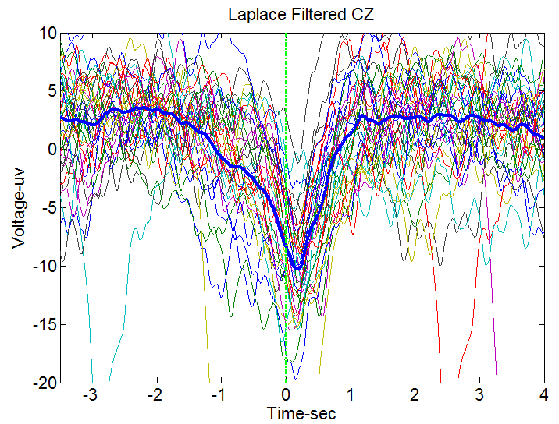
Introduction | Intraoperative ECoG | Stereo-EEG | MRCP | platform | Further
Subject 3 (脑干出血病人)
采集设备：NeuroScan; 采样频率：1250Hz； 硬件带宽设置：DC~200Hz ； 50Hz工频滤波。
受试者介绍：31，男，脑干出血，发病6个月，导致左侧肢体控制障碍，但是依然可完成抬腿动作。
此组数据主要看一例脑干出血病人在自主动作下的MRCP, 受试者随机间隔5~10S动作。
[Source: SJTU BCI Lab]

Slide 27

Introduction | Intraoperative ECoG | Stereo-EEG | MRCP | platform | Further
Author | Journal | True positive rate | Latency
I. K. Niazi | J. Neural Eng. | Offline 82.5% | -66.6ms
Ren Xu | IEEE TBME | Online 79% | 315ms
Ning Jiang | Clinical neurophysiology | Offline 76.9% | -156ms
With ECoG:
Higher true positive rate?
Lower latency?
Precise localization of the signal source?
（点我）

Slide 28
Introduction | Intraoperative ECoG | Stereo-EEG | MRCP | platform | Further
Platform set-up

Slide 29

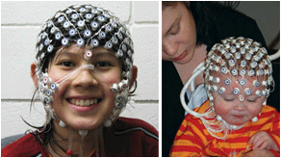
Introduction | Intraoperative ECoG | Stereo-EEG | MRCP | platform | Further
E-prime 软件目前是国际心理学界通用的标准化心理实验设计软件，可以兼容NeuroScan, Brain Product, EGI. 目前该软件已经调通，可以和NeuroScan通信，之后可以直接将设备拿到医院采集ECoG信号，实时向脑电信号中打入标签。
如果仅需要离线分析数据，可以考虑直接使用医院的设备采集ECoG信号，但前提是该设备能够提供trigger接口，并且兼容E-prime软件，这可以大大简化ECoG实验准备。
华山医院神经外科目前具备一套256通道EGI脑电图系统，具备非常高性能的脑电采集能力，并且兼容E-prime，可以使用该设备进行MRCP等研究工作。

Slide 30
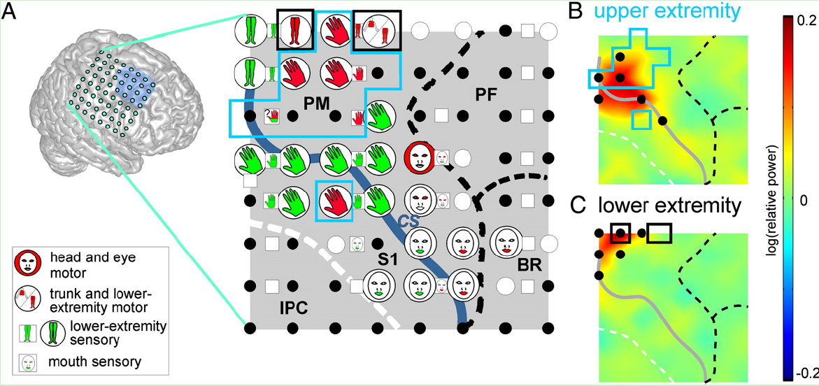
Introduction | Intraoperative ECoG | Stereo-EEG | MRCP | platform | Further
(1) ECoG 采集平台搭建
离线分析平台搭建：采用Neuroscan 或者医院的设备，搭配e-prime软件完成数据采集；
在线分析平台搭建：需要我们自己编写C++, 或者基于BCI2000开发相应的软件；
(2) ECoG 电极与脑皮层精确定位
不知现在已有的商业软件能否实现这一功能，如果不能实现，我们还需要自己编写代码实现

Slide 31
Introduction | Intraoperative ECoG | Stereo-EEG | MRCP | platform | Further
(3) 选择一例合适的癫痫病人，全程分析其数据，为后续大批量实验做准备。
第一阶段：获取ECoG电极植入前病人MRI功能结构像，结合ECoG电极植入后的CT像，实现ECoG电极与脑皮层的三维图像显示；
第二阶段(off-line, 离线数据分析)：
采集ECoG-MRCP，用于脑机接口研究；
采集不同动作模式下的ECoG信号，用于脑功能区定位研究；
全程同步记录病人ECoG+video+EMG, 通过non-experimental 数据定位相应的功能区[1];
第三阶段(on-line, 在线数据分析)：
研究“双向侵入式脑机接口”，区分不同手指的刺激，区分压力、振动、滑动、刚度、材质不同 触觉信息。（可实现性，刺激电极能否与假肢手的传感器对接？）；
基于C++或者BCI2000编写软件，通过分析ECoG信号，实现功能区real-time显示，从而指导临床手术；
基于C++或者BCI2000编写软件，实现控制指令的时时输出，从而实现在线控制假肢手的目的。
[1] Johanna Ruescher.etc. Somatotopic mapping of natural upper- and lower-extremity movements and speech production with high gamma electrocorticography, NeuroImage, 2013

Slide 32
Thanks

